Slide 1
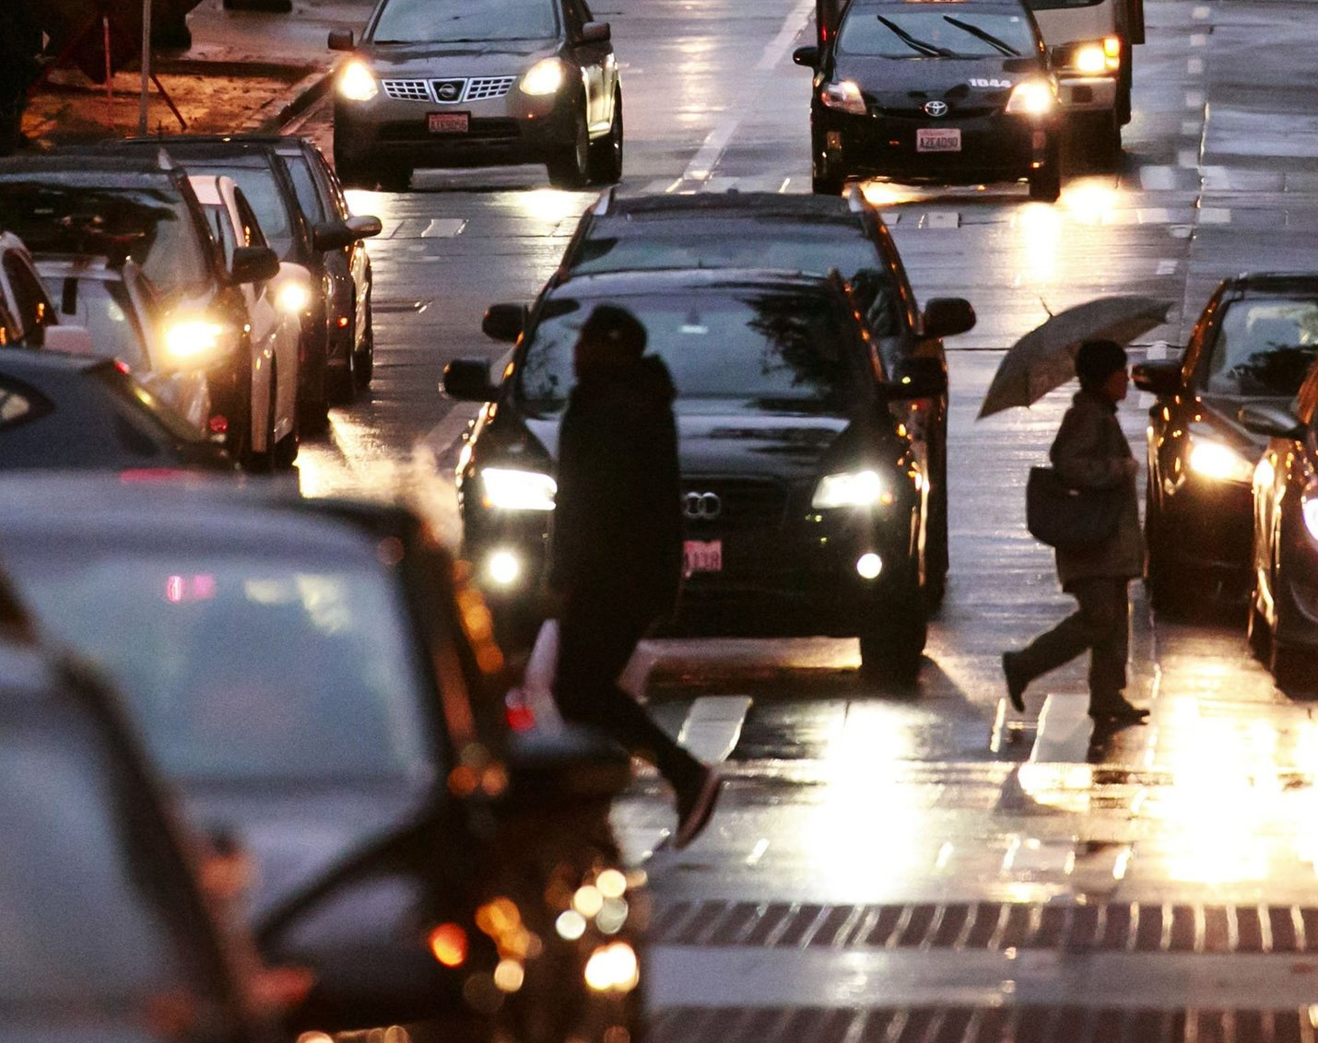
IBM CAPSTONE PROJECT
Car Accident Severity – Seattle, Washington Submitted by – Harsh Janyani

Slide 2
Objective
Seattle is the largest city in both the state of Washington and the Pacific Northwest region of North America.
The overall number of Seattle's car population is 435,000. That's more than 5,000 cars per square mile or 637 cars for every 1,000 residents.
Around 1.35 million people die annually in traffic accidents globally, an average of 3,700 people risk their lives on the highways every day, and a further 20-50 million suffer non-fatal injuries, frequently resulting in long-term disability.
To Predict the Severity of an accident in Seattle, Washington by understanding the various factors involved using Machine Learning Models

Slide 3
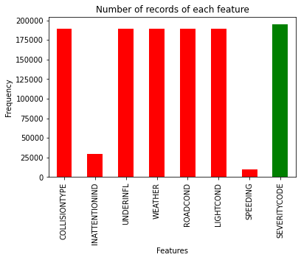
Data Understanding
The details pertaining to the car crashes include the severity of each traffic crash, along with the time and circumstances in which each accident happened
The dataset has a total of 1,94,673 observations along with 38 features
Selected features are categorical features
Many features have missing values

Slide 4
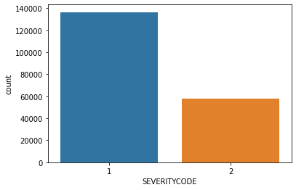
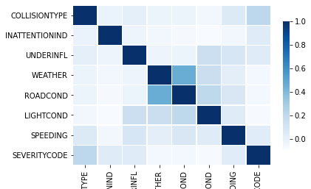
Exploratory Data Analysis
Dataset has imbalanced target variable
Using SMOTE oversampling method, target variable is balanced
Correlation between severity code and other features is low
Collision Type has the highest correlation with severity code

Slide 5
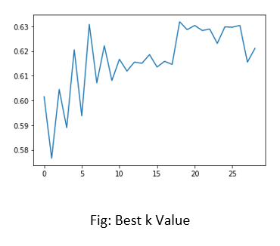
Predictive Modelling
For making predictions, 3 types of models were tested which are as follows:
Logistic Regression
Decision Trees
k-Nearest Neighbors
These models were used from two packages Sklearn and PyCaret.

Slide 6
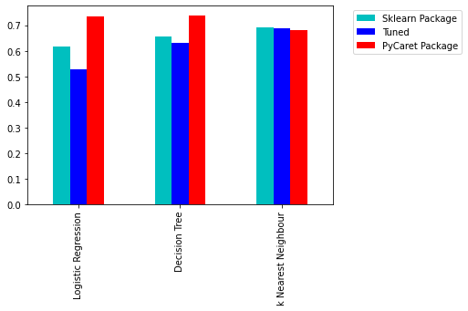
Evaluation
Each model was evaluated by generating classification report
Comparison plot was generated for the accuracies of all the models
On Comparing, it is conclusive that models from PyCaret package had a better performance compared to Sklearn package

Slide 7
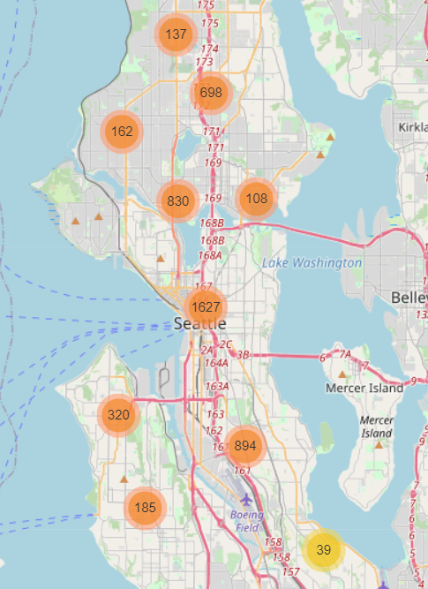
Recommendations
Most of accidents can be seen on the main roads of the city, specifically near the highway in the city center
Try to be careful and attentive while driving
Many incidents occur under adverse weather, road and light conditions
Precautions should be taken under such circumstances

Slide 8
Thank You

